Slide 1
Assessing the Population-level Impacts of Marine Protected Areas
IMPAC 2023 Dan Ovando

Slide 2
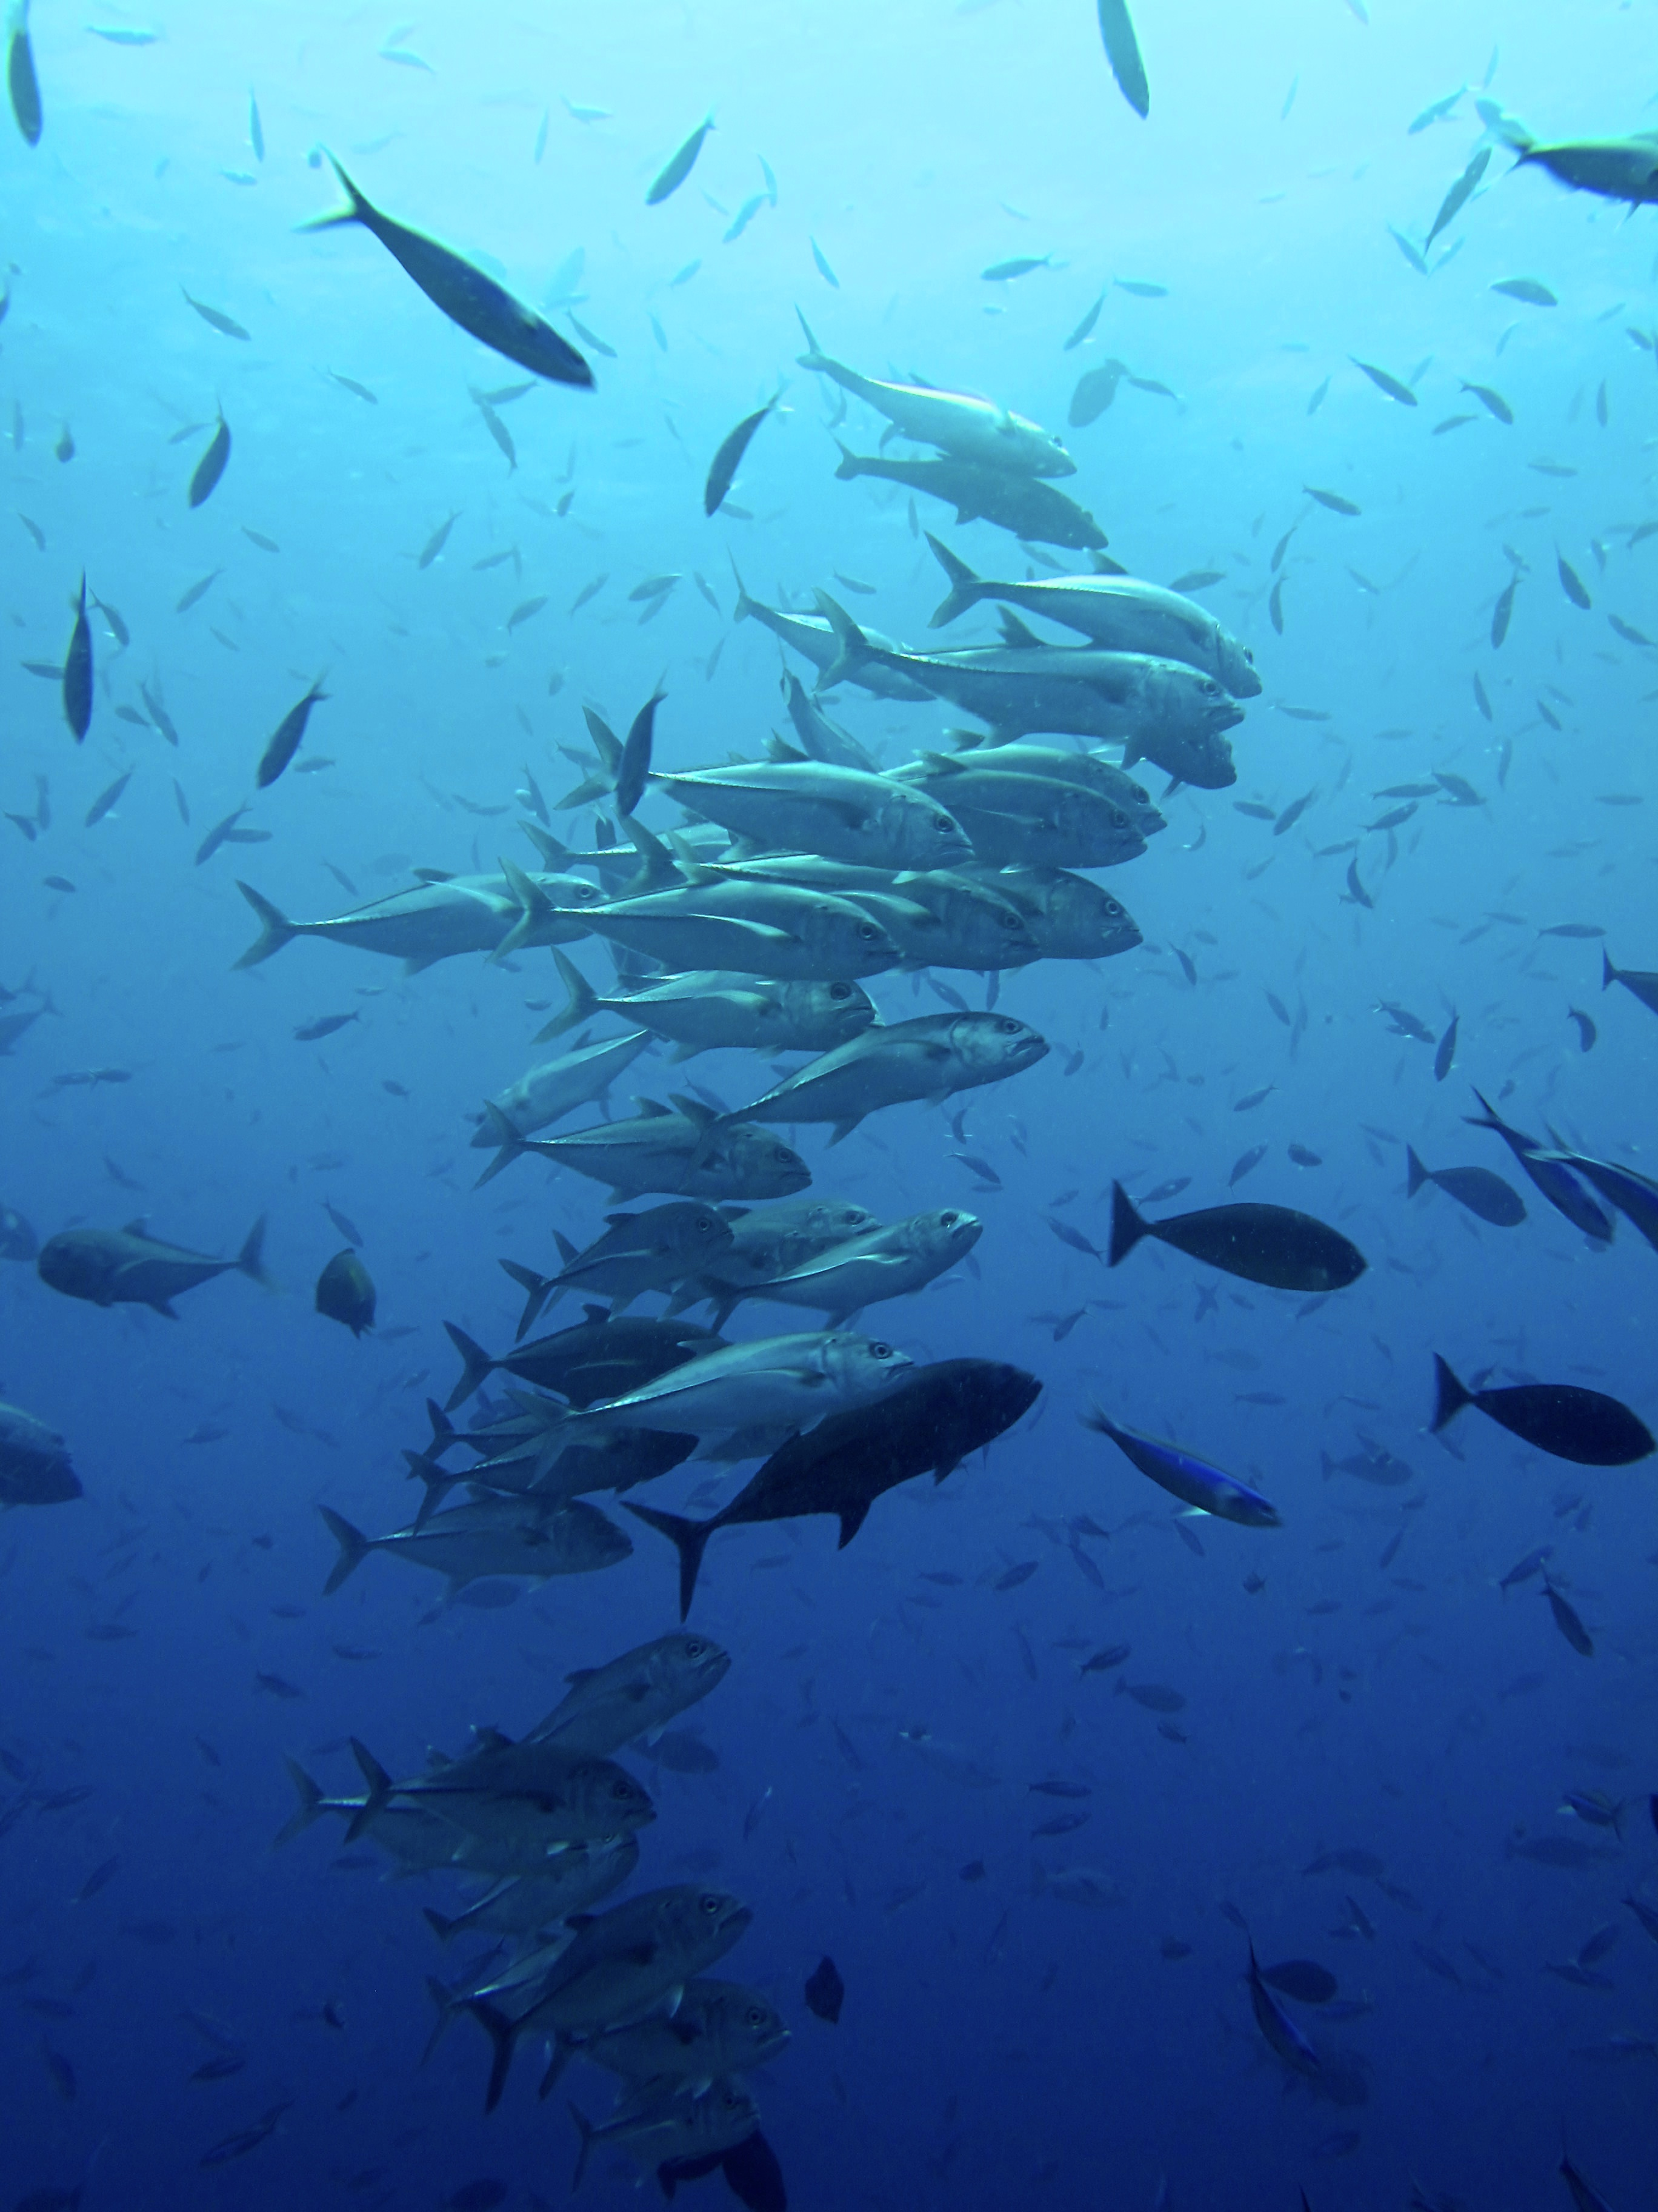
MPAs have Complex Effects
Modern protected areas first seen as refuges from the outside world
Protection has wider impacts
“spillover” of adult or larval organisms
Displacement of human activities
Across multiple species and fleets!
Creates a challenge for both predicting and estimating effects of spatial policies

Slide 3
What effects do protected areas have on populations?

Slide 4
MPAs - The Evidence
The jury is in on marine reserves: They work. Research has repeatedly shown that fish numbers quickly climb following well-enforced fishing bans, creating tangible benefits for fishers who work the surrounding waters.
NPR 2018

Slide 5
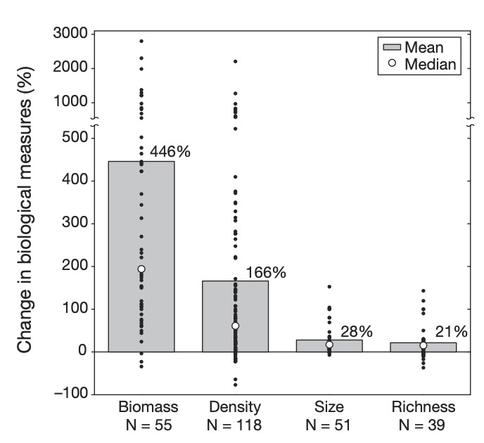
MPAs - The Evidence
MPAs seem simple:
Less fishing, more fish
Ample evidence of more everything inside MPAs than outside
Problem solved?
Fish and Fishers move
What do we do when the treatment affects the control

Slide 6
Population-Level Effects of MPAs
Notes:
Relatively sedentary adults, widely dispersed larvae with post-settlement density dependence

Slide 7
Population-Level Effects of MPAs
Notes:
Relatively sedentary adults, widely dispersed larvae with post-settlement density dependence

Slide 8
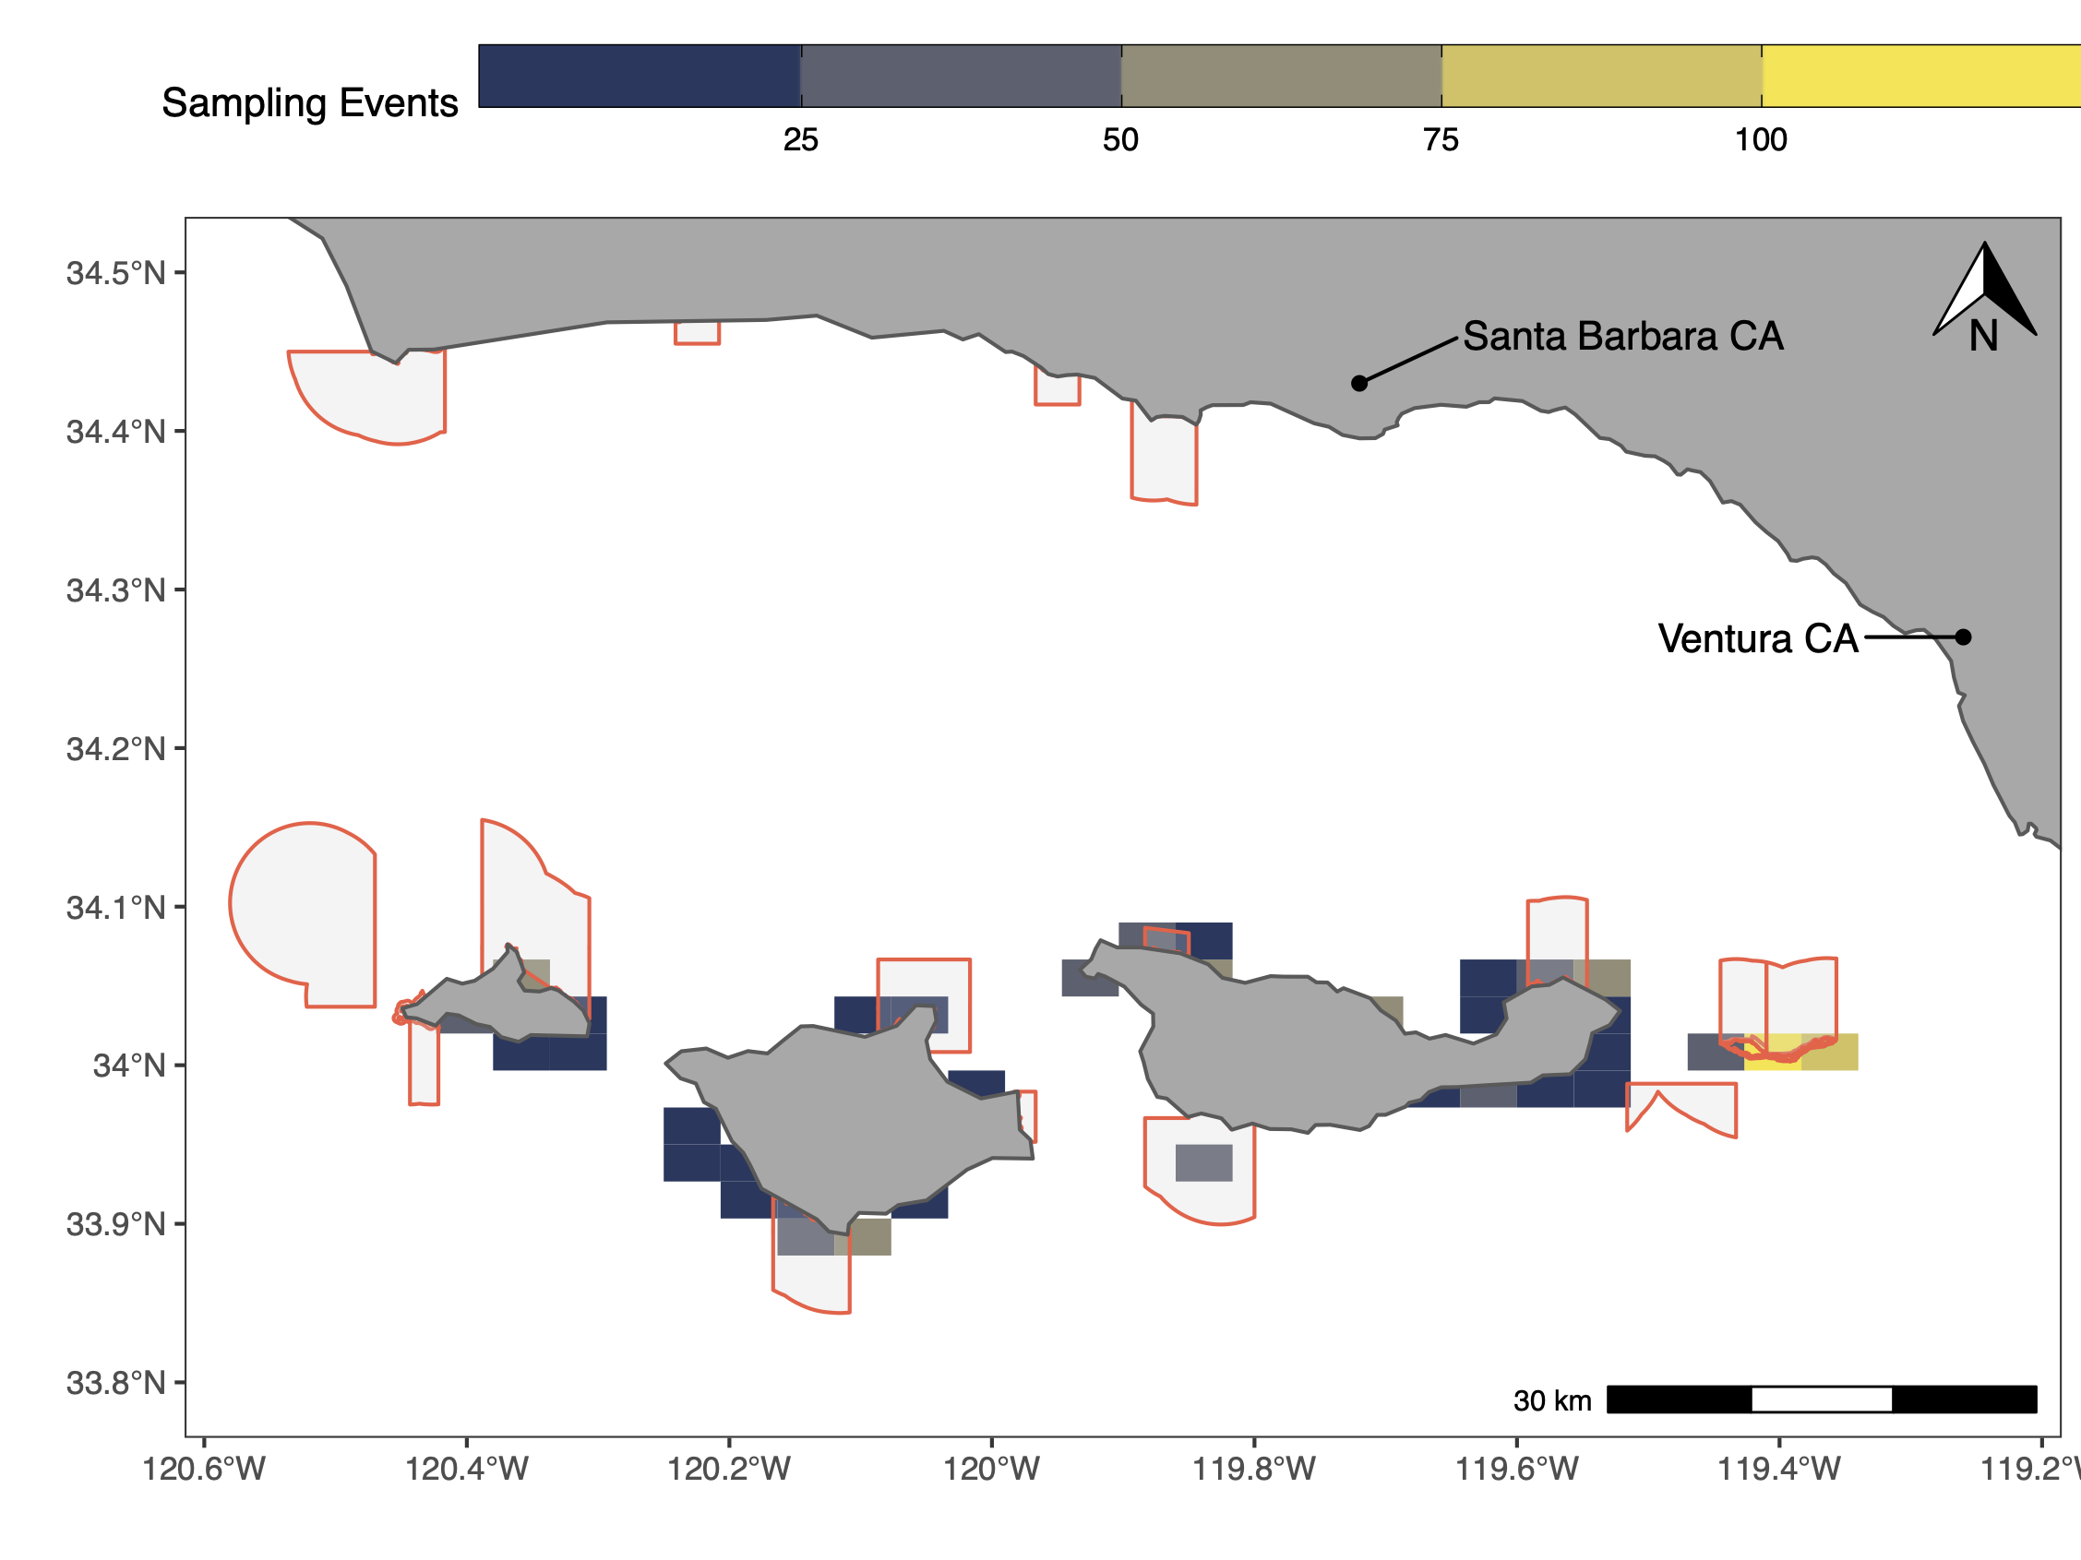
Case Study: Channel Islands MPAs

Slide 9
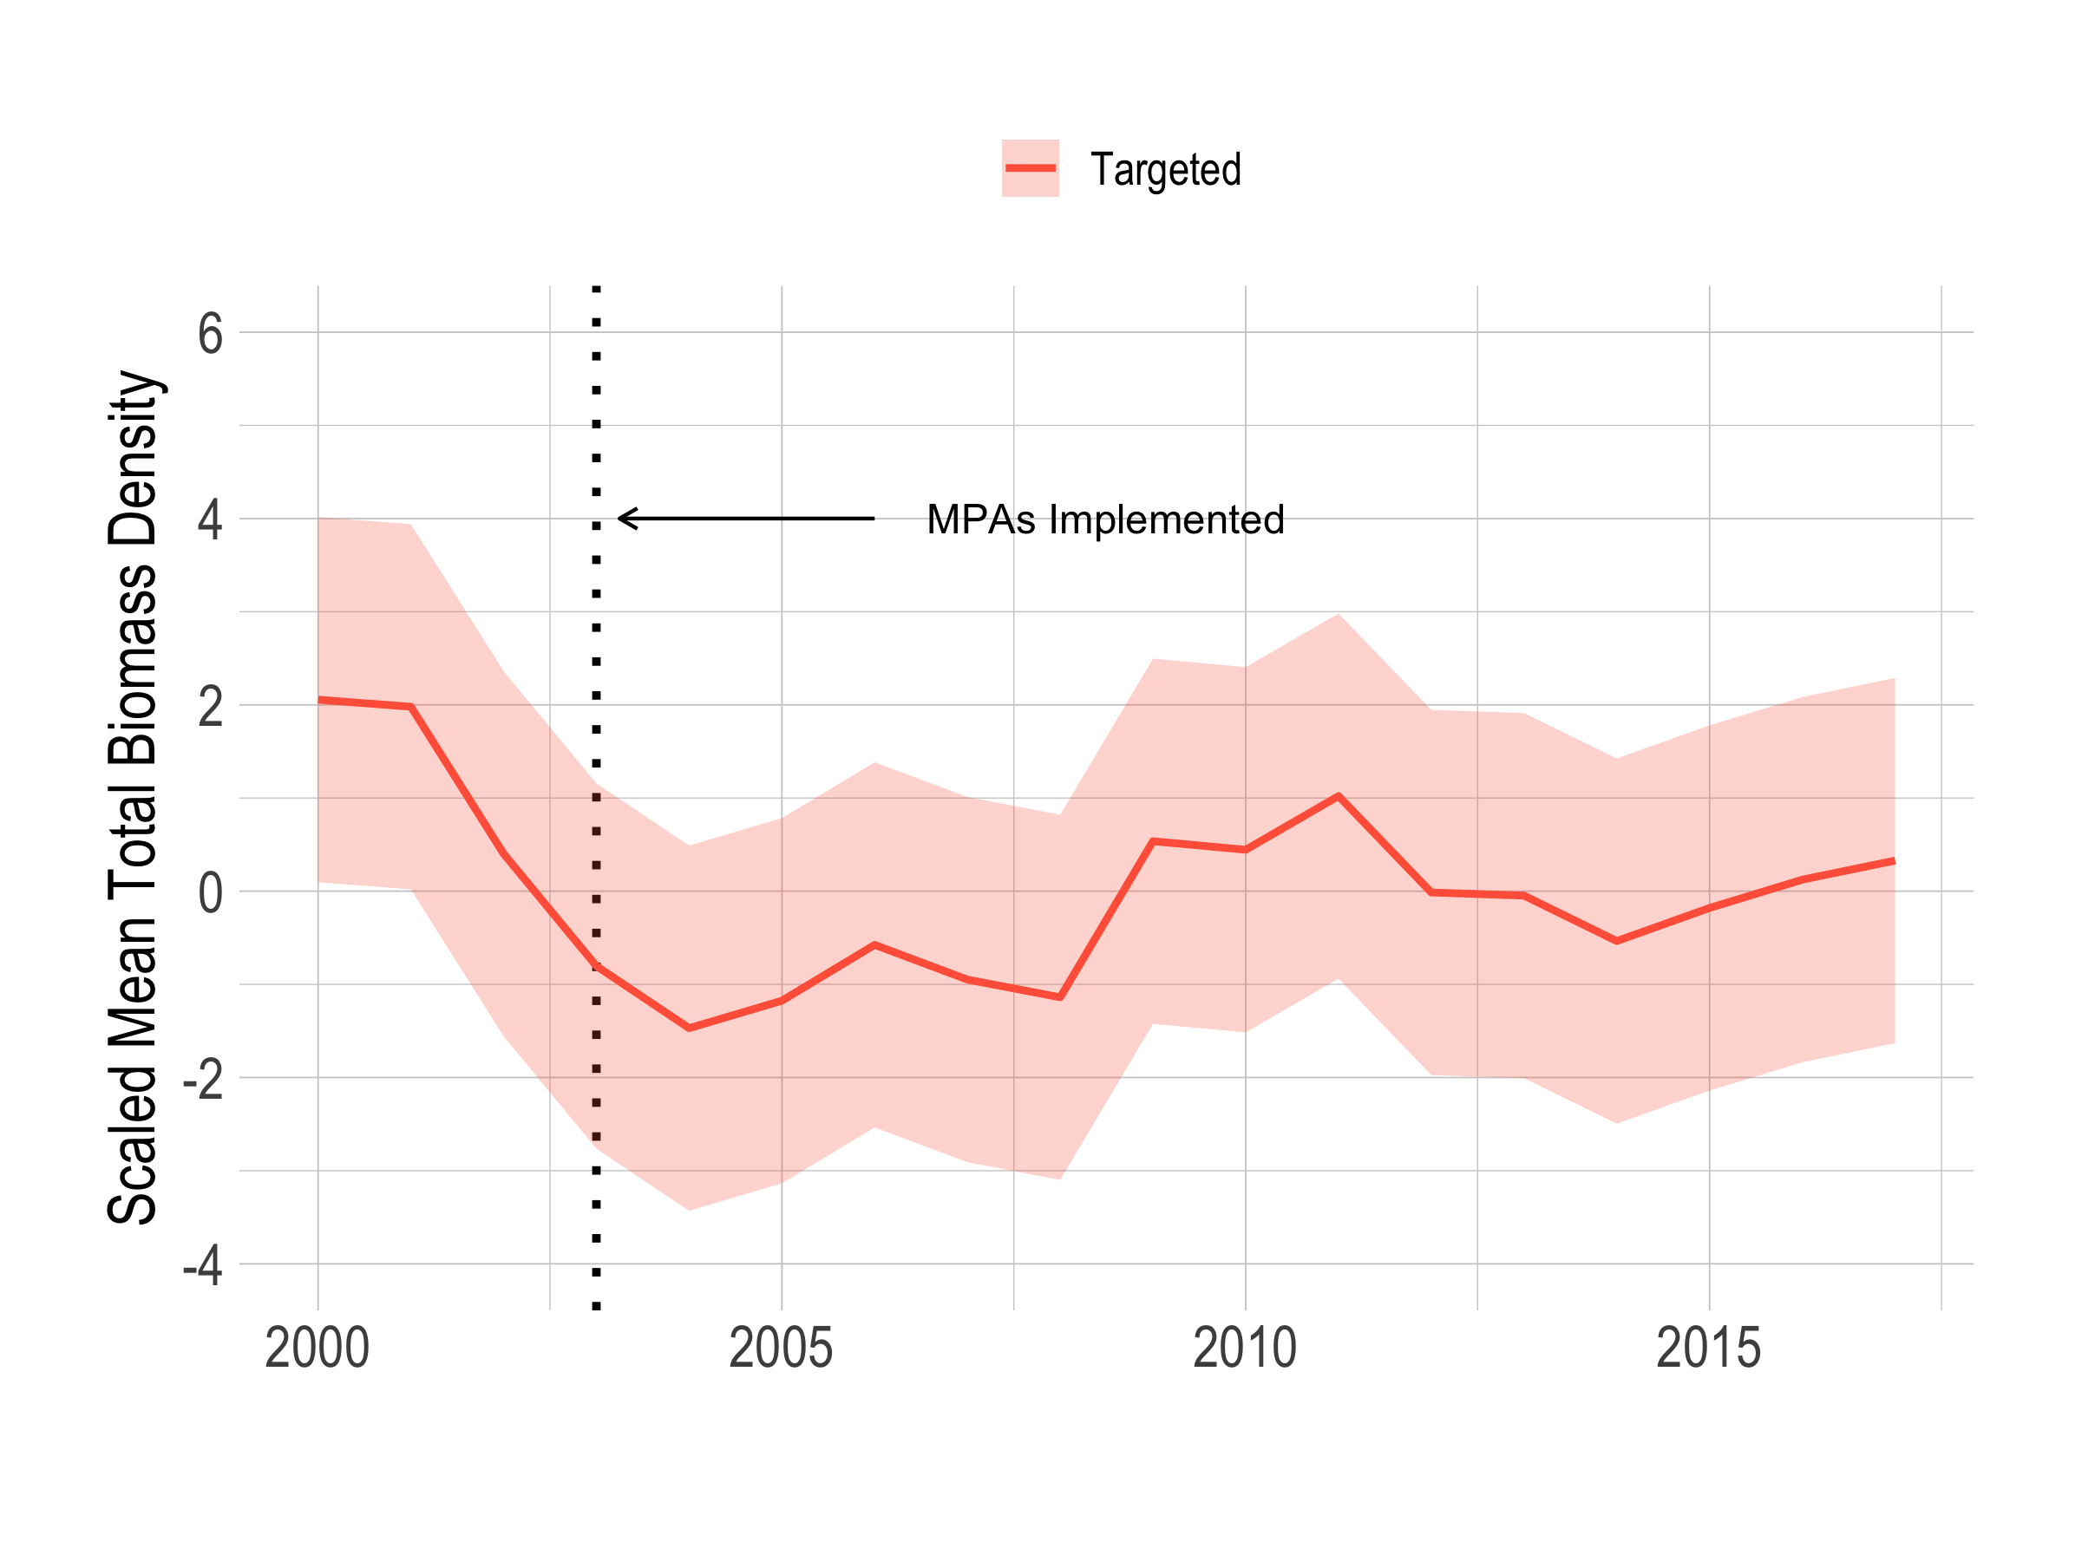
What Happend in the Channel Islands?

Slide 10
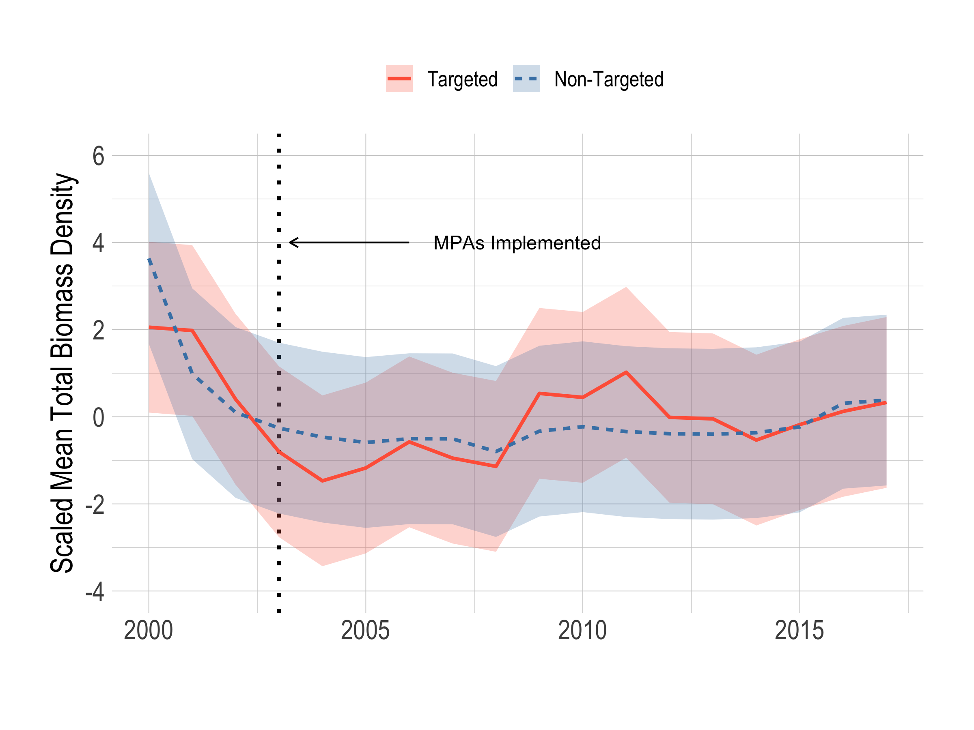
What Happend in the Channel Islands?

Slide 11
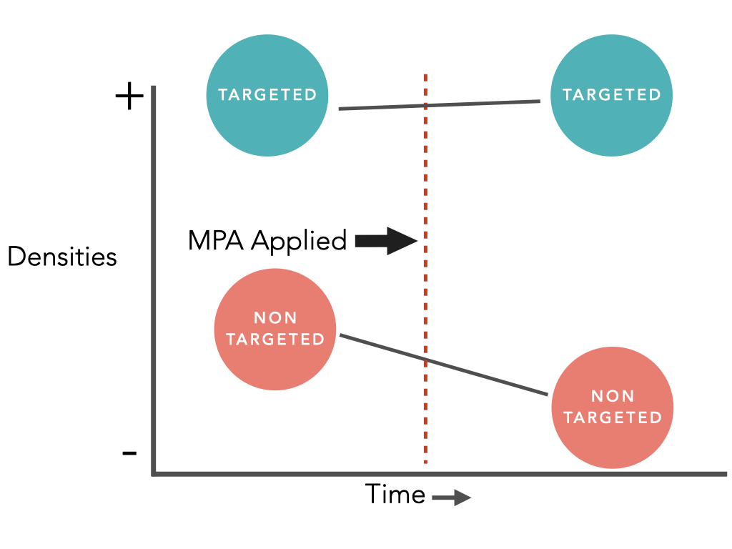
Estimating Population-Level Effects

Slide 12
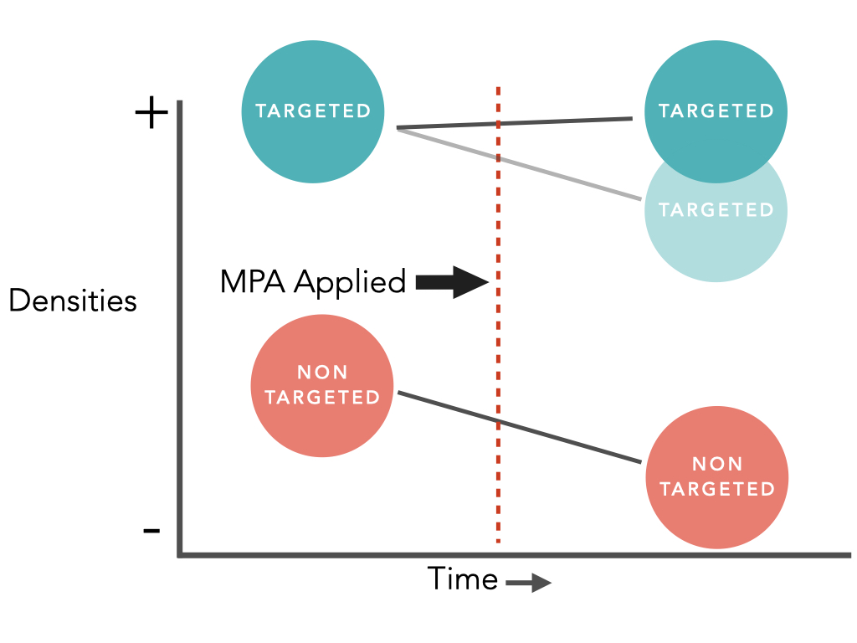
Estimating Population-Level Effects

Slide 13
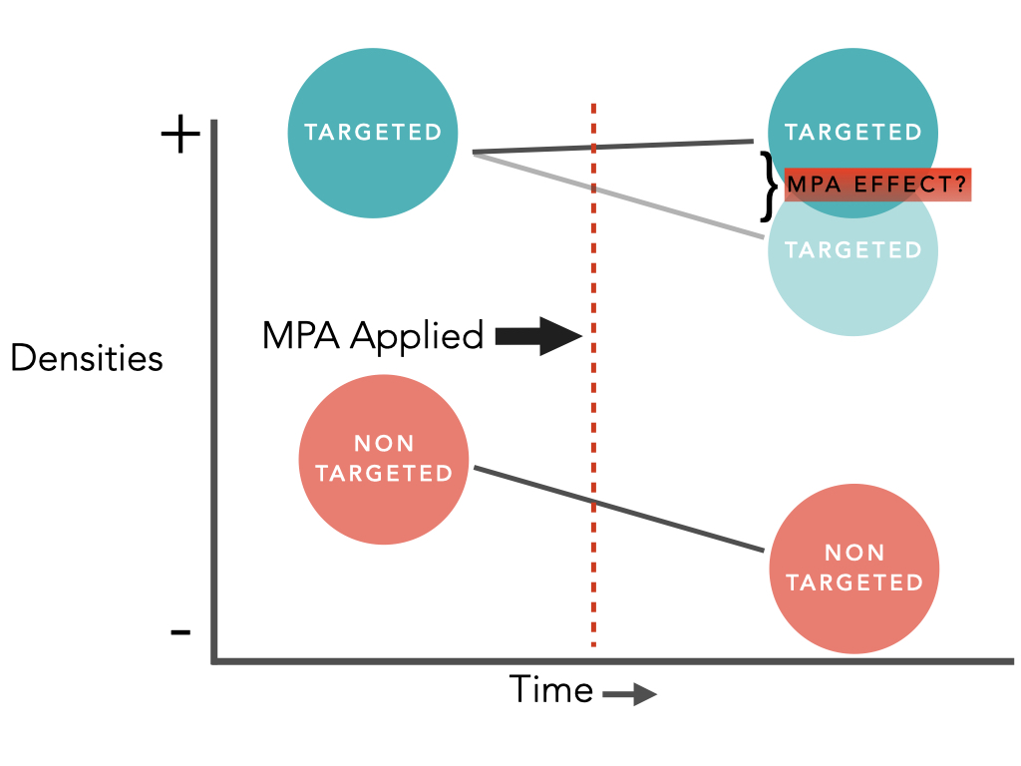
Estimating Population-Level Effects

Slide 14
Estimating Population-Level Effects
General form
$$\left(log\left(D_{MPA=1,T=1}\right)−log\left(D_{MPA=0,T=1}\right)\right)−\left(log\left(D_{MPA=1,T=0}\right)−log\left(D_{MPA=0,T=0}\right)\right)$$
Bayesian Gamma GLM
$$d_{i}∼Gamma\left(e^{β_{0}+β_{1}T_{i}+β_{2}MPA_{i}+β_{3}T_{i}MPA_{i}+B^{c}X_{i}+B^{s}S_{i}},shape\right)$$
Hierarchical clustering of sites by island
$$B^{s}∼N\left(β_{r},σ_{r}\right)$$

Slide 15
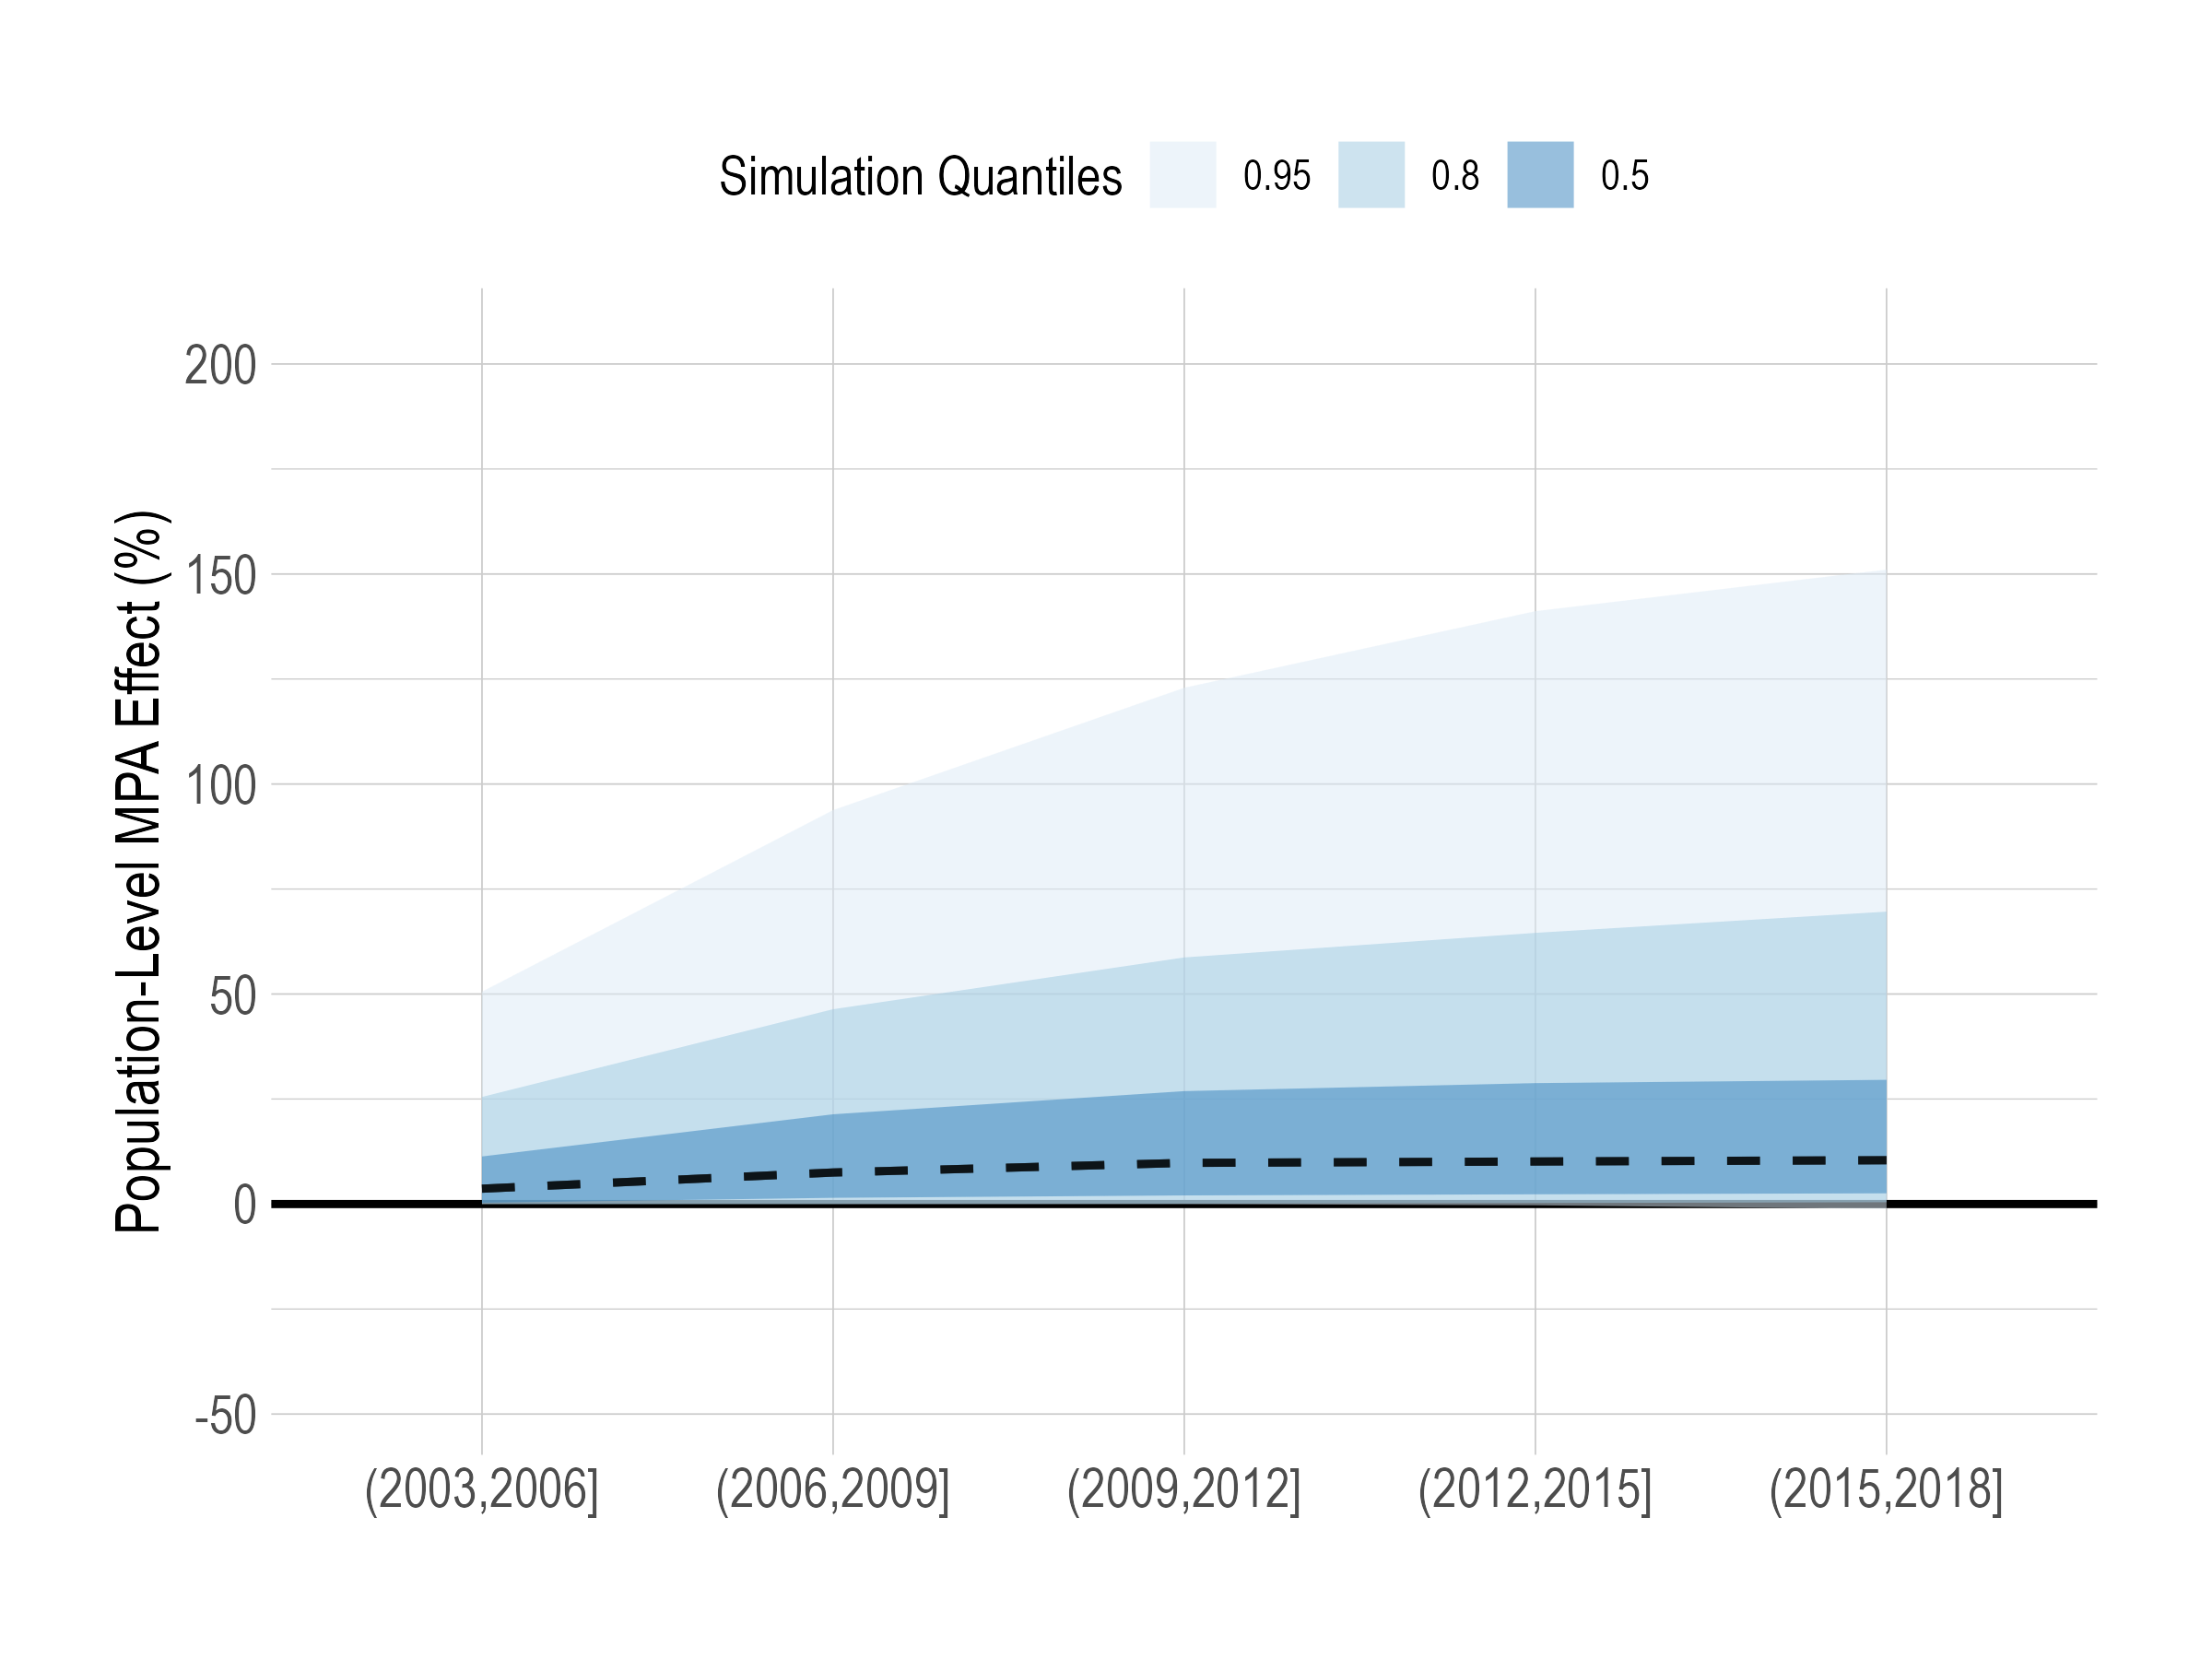
Population-Level Effects of MPAs

Slide 16
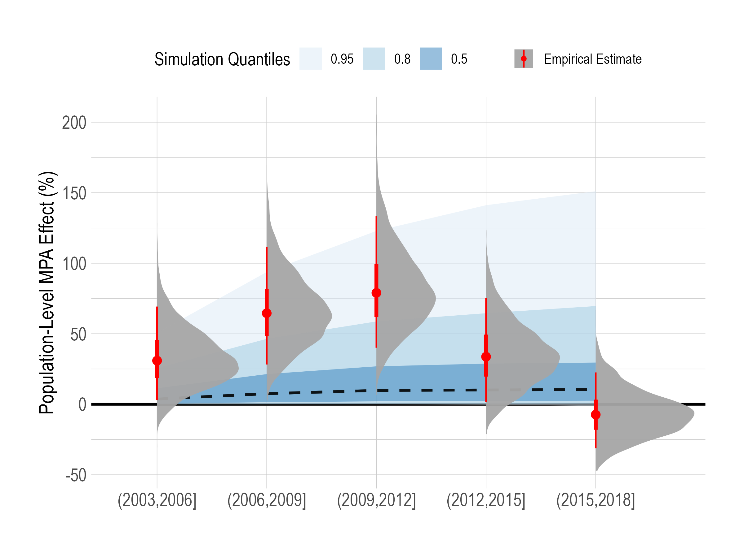
Population-Level Effects of MPAs

Slide 17
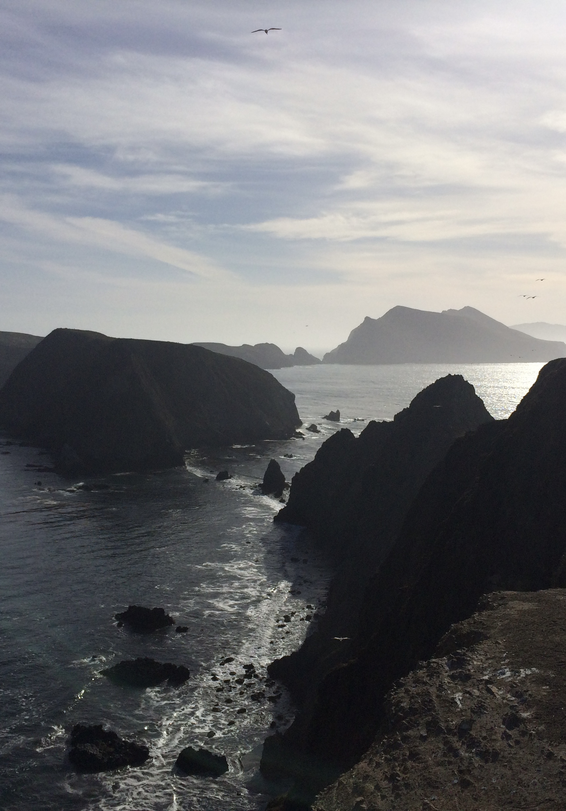
Effects of Protected Areas
Critical to consider effects inside and outside
Population effects may be smaller and harder to find than conventionally thought
Uncertainty does not preclude action
Communities should have a clear understanding of full range of possible effects of protected areas

Slide 18
The Catch-22 of MPA Design
The closer your control site, the more risk of spillover. The further, the less likely it is a valid environmental control

Slide 19
Extras

Slide 20
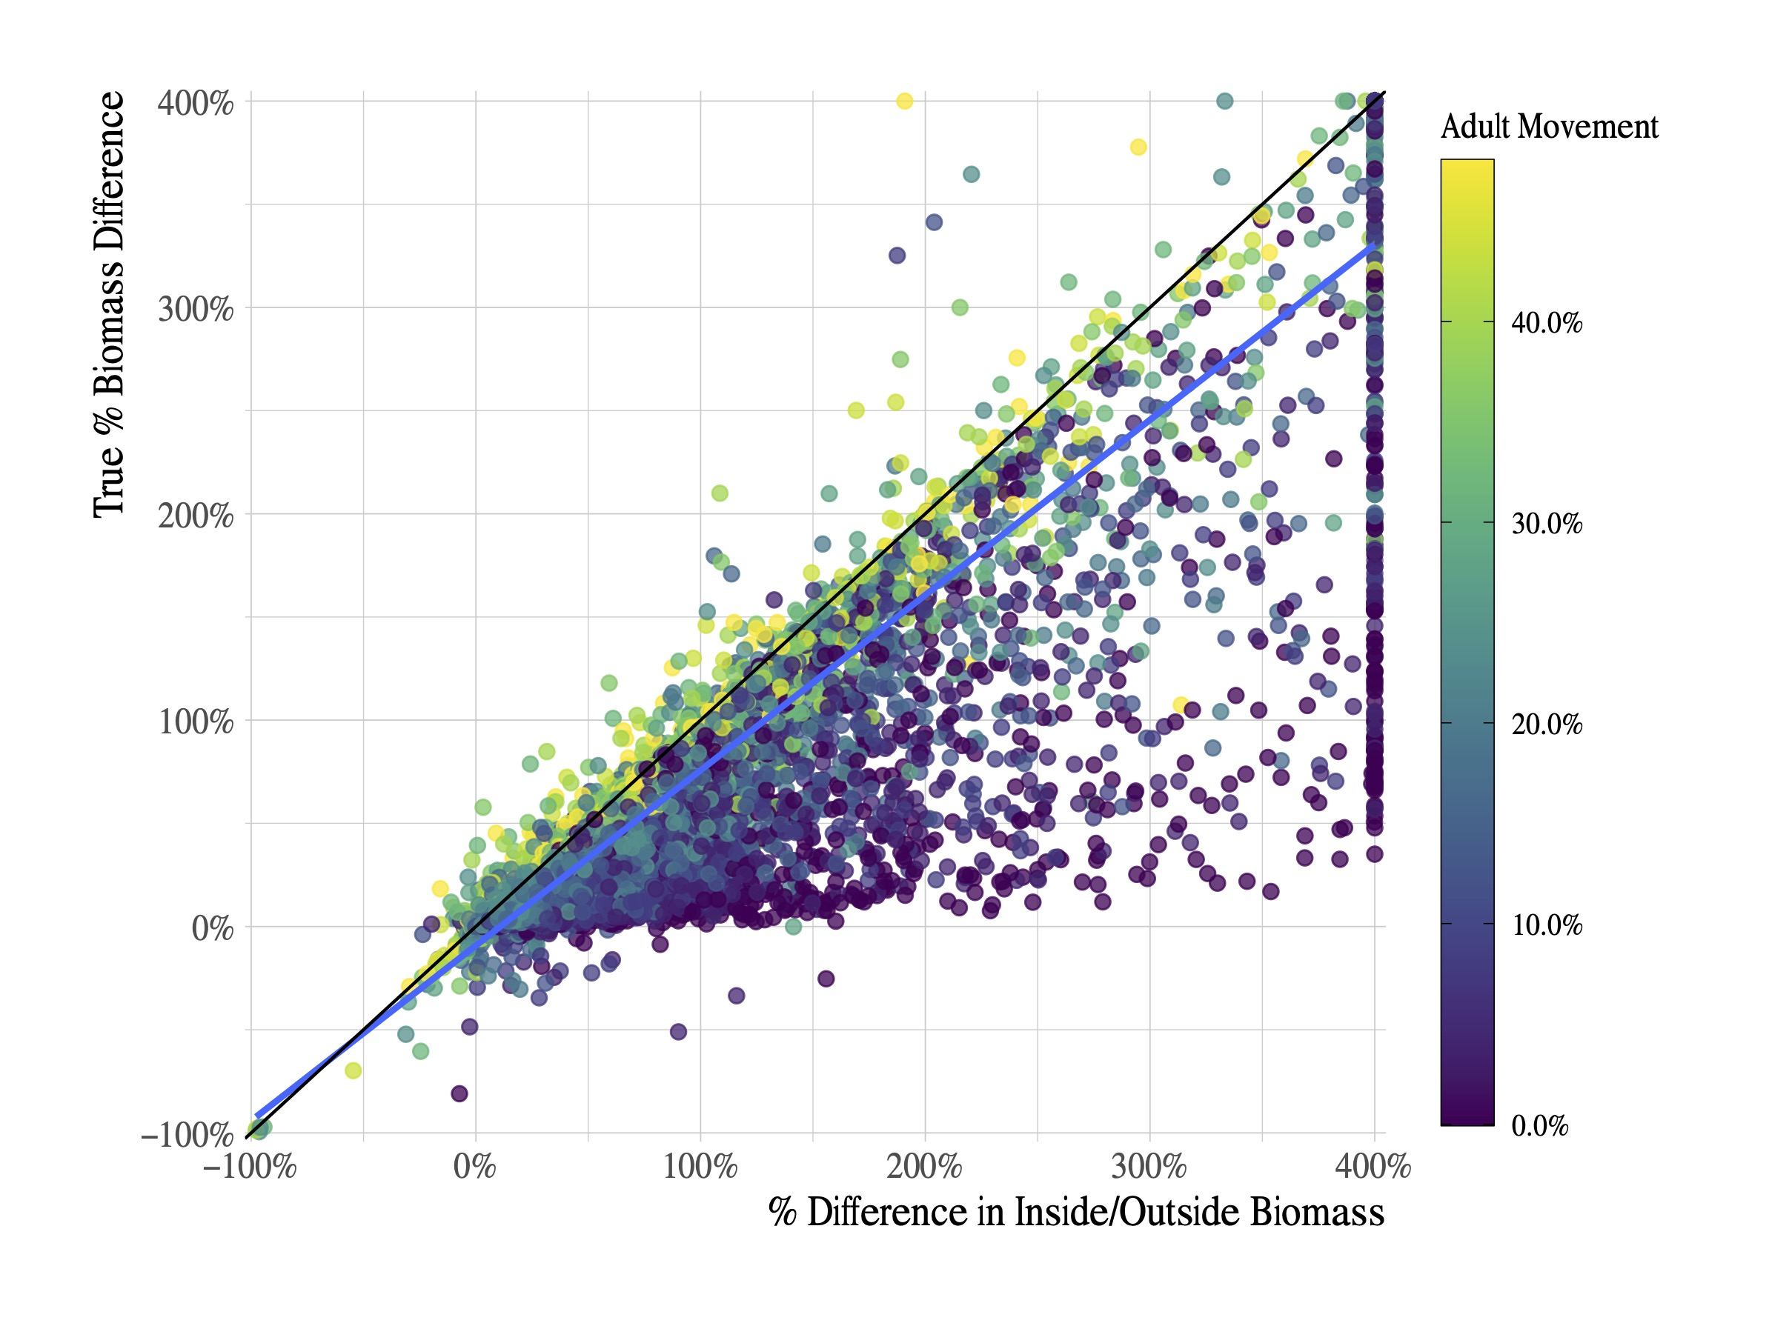
Inside vs. Outside = Effect?

Slide 21
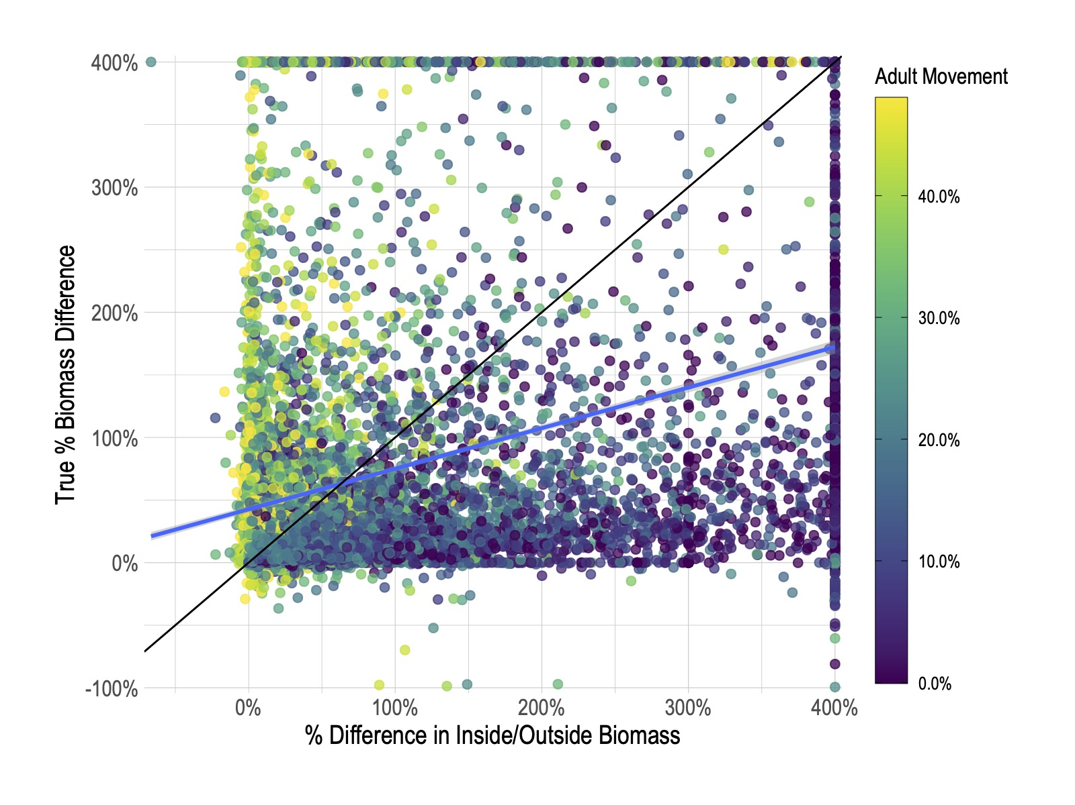
Inside vs. Outside = Effect?

